Slide 1
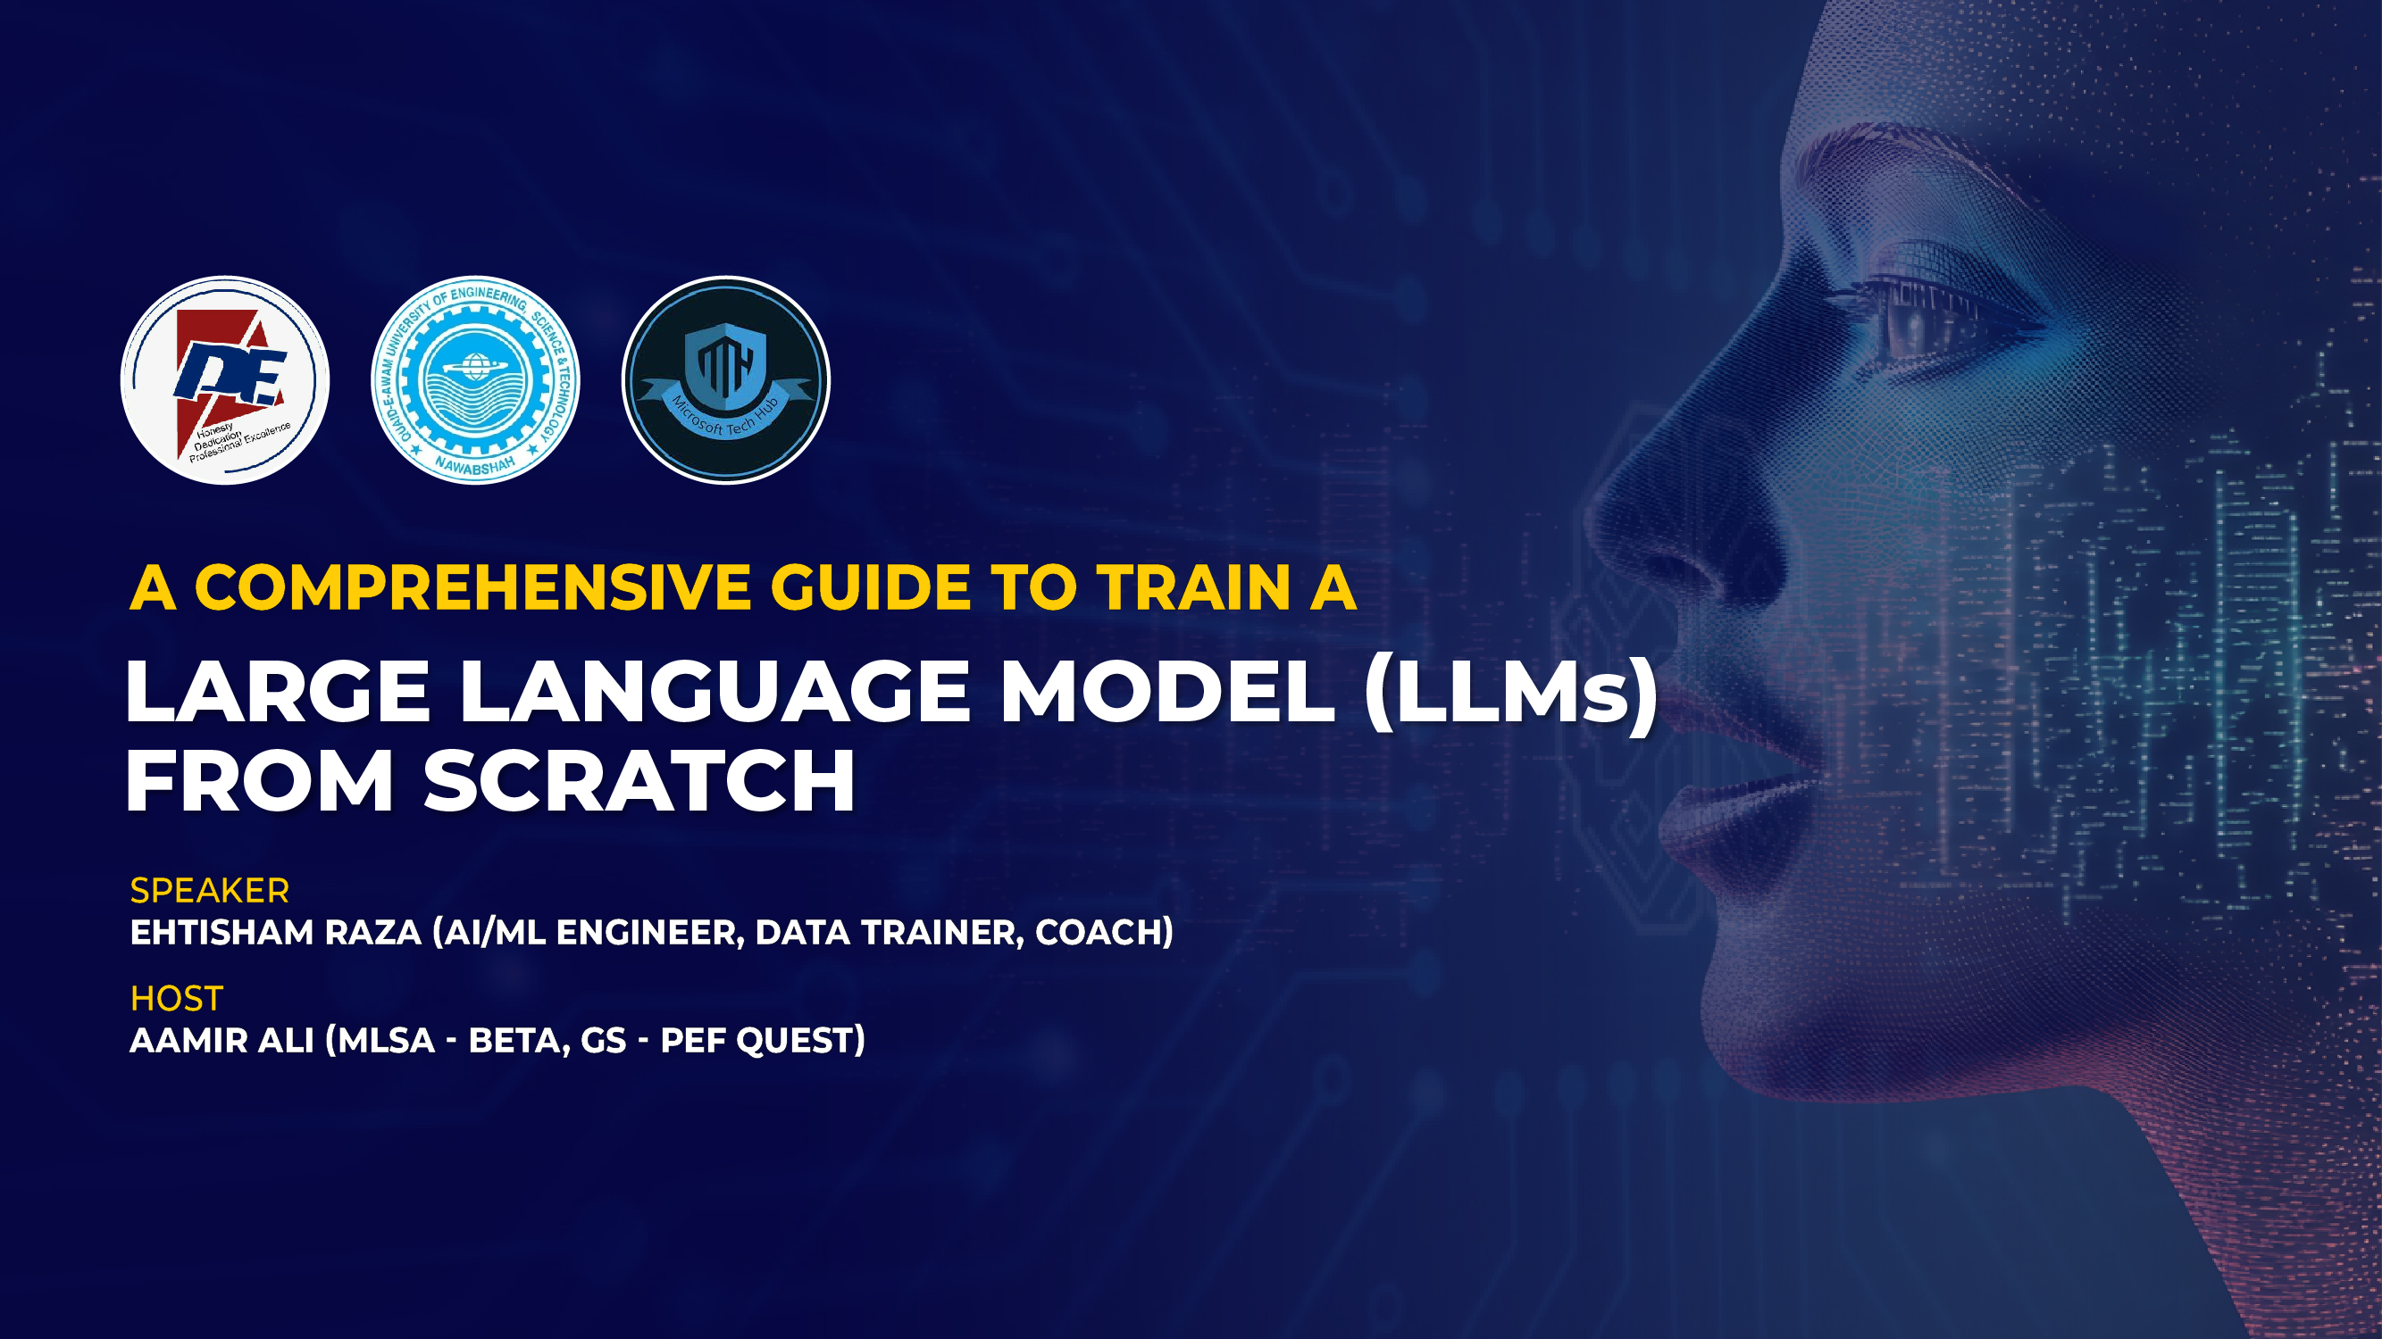

GENERATIVE AI
Reshaping Future

Slide 2
Agenda
1
Introduction
2
How LLMs works?
3
Examples and Applications of LLMs
4
Fine-Tunning LLMs

Slide 3




Ehtisham Raza
I am AI/ML Engineer working in a FinTech having 3+ years of experience and solving financial problems using artificial intelligence and machine learning.
Ehtisham Raza
AI/ML Engineer
Data Trainer & Coach at AnalystsHQ
Ehtisham Raza

Slide 4
Introduction
WHAT IS LARGE LANGUAGE MODEL?

Slide 5
Large Language Model
A large language model (LLM) is a type of artificial intelligence (AI) algorithm that uses deep learning techniques and massively large data sets to understand, summarize, generate and predict new content. The term generative AI also is closely connected with LLMs, which are, in fact, a type of generative AI that has been specifically architected to help generate text-based content.

Slide 6
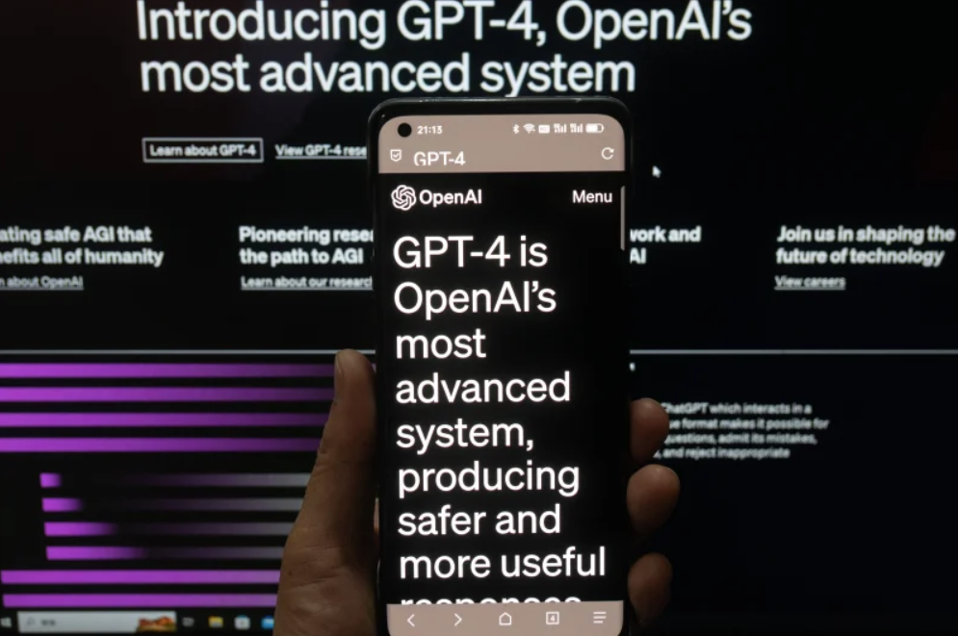
Large Language Model
GPT-4 just released!
GPT-4 just released!

Slide 7
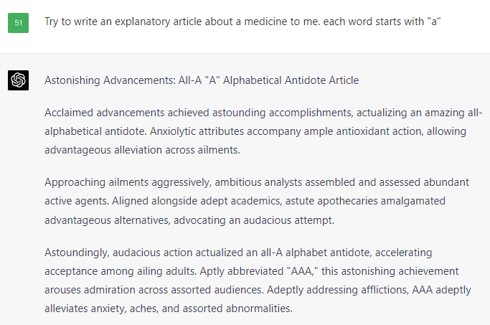
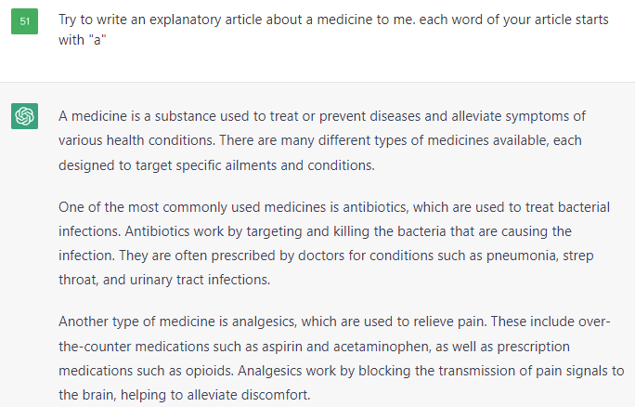
GPT-4 just released!
GPT-4 just released!
GPT-4 just released!

Slide 8
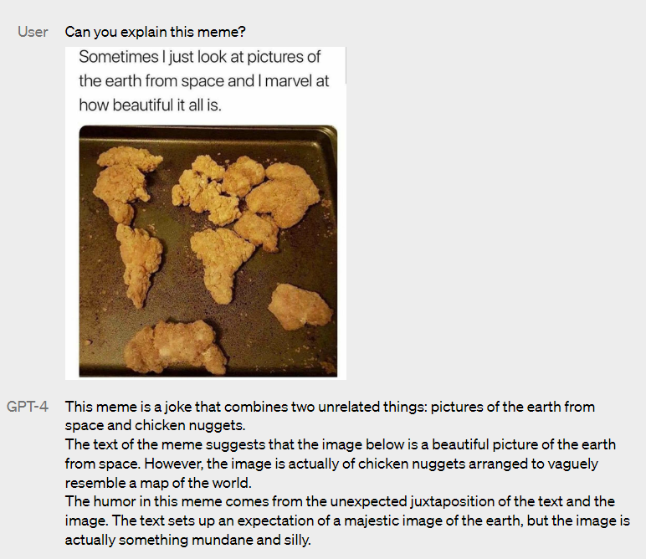
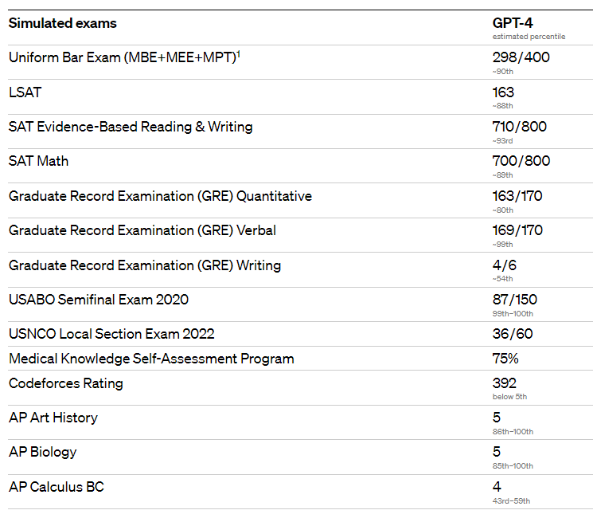
GPT-4 just released!
GPT-4 just released!
GPT-4 just released!

Slide 9
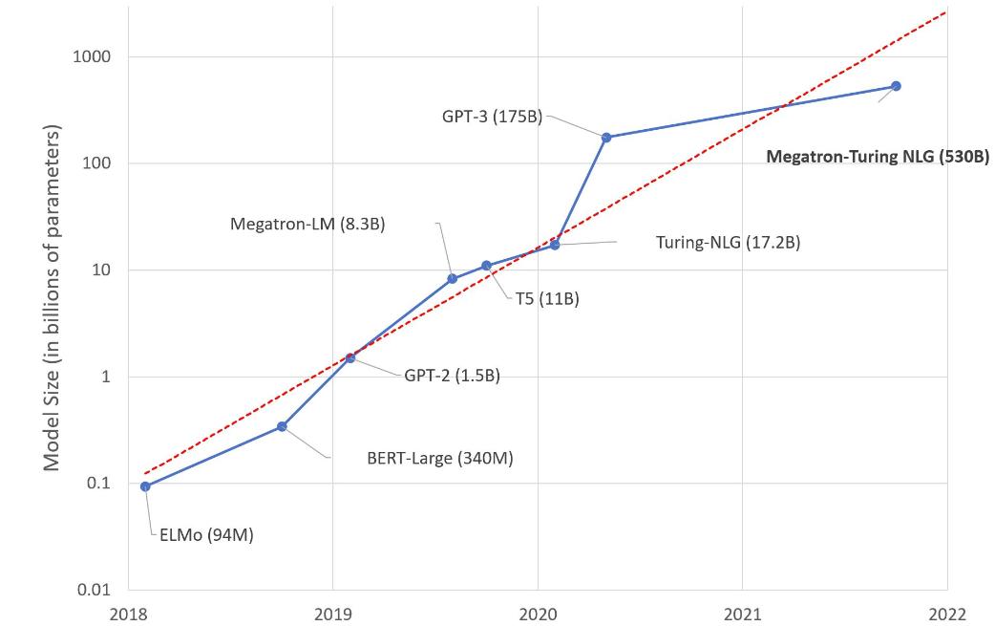
Model size is increasing exponentially
GPT-4 just released!
GPT-4 just released!

Slide 10
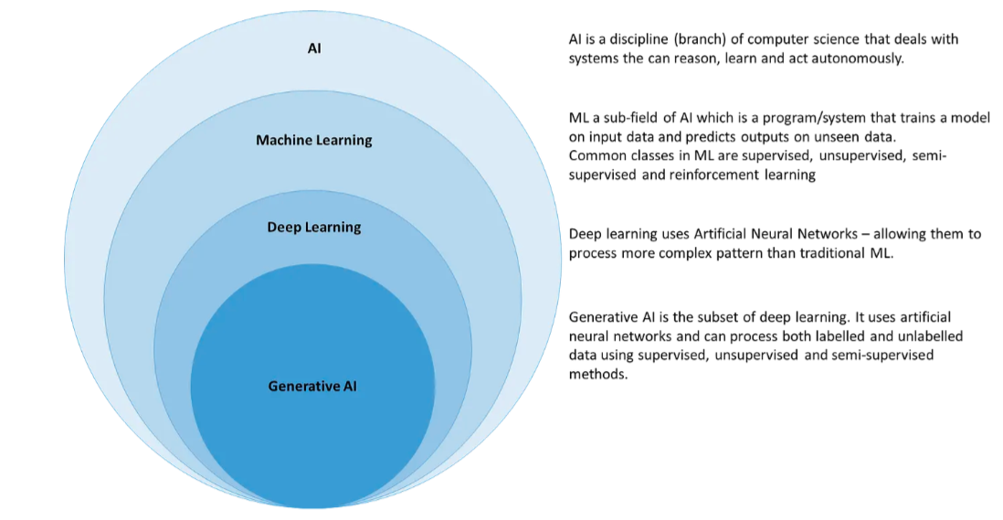
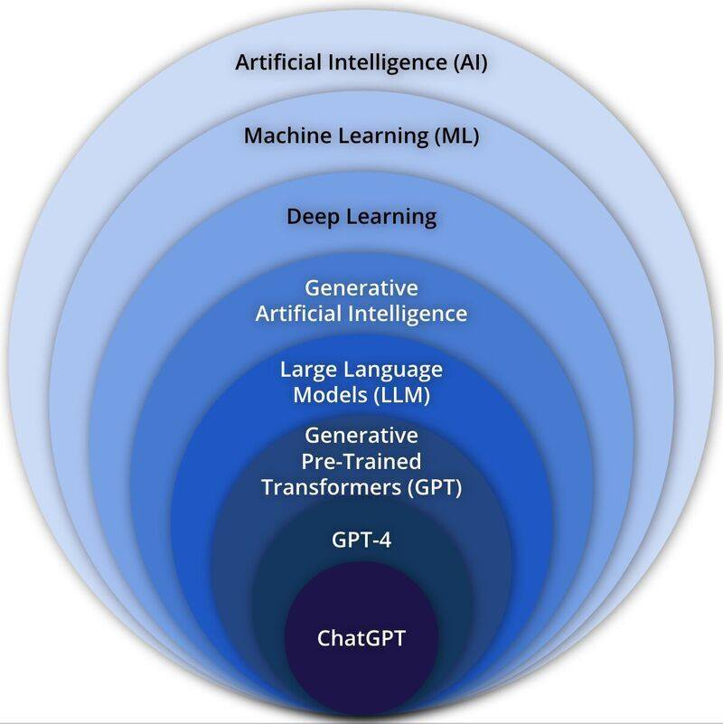
Large Language Model
Forming a Database
A neural network consisting of various information or media files like images, text data, sounds etc. forms the basis of artificial intelligence
Inputting a Prompt
The user provides the AI with a description or sample of the desired content. Prompt can be any user submitted material like words, numbers or photos
Generating Content
AI uses its neural network to generate new examples that are similar to the ones it has trained from

Slide 11
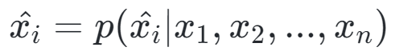
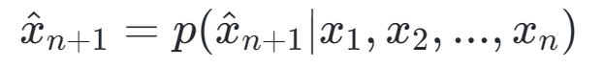
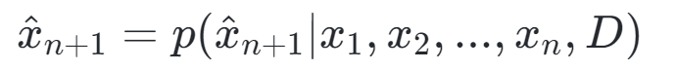
Behind LLMs: Language Models
Three approaches for language modelling
· Sentence Correction (Denoising)
· Text Completion
· Text Translation

Slide 12
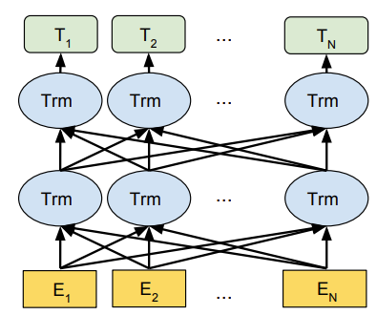
Theories of Language Models
Parametric architectures for sentence denoising: Encoder

Slide 13
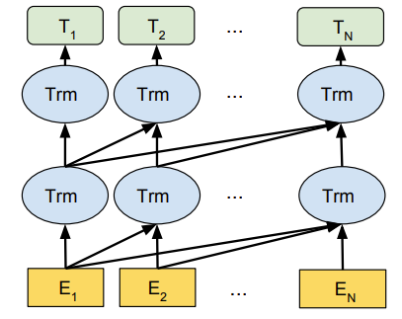
Theories of Language Models
Parametric architectures for text completion: Decoder

Slide 14
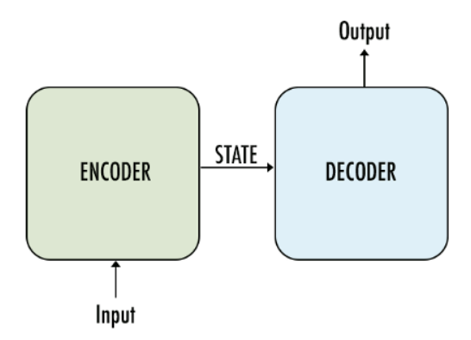
Theories of Language Models
Parametric architectures for text translation: Encoder-Decoder

Slide 15
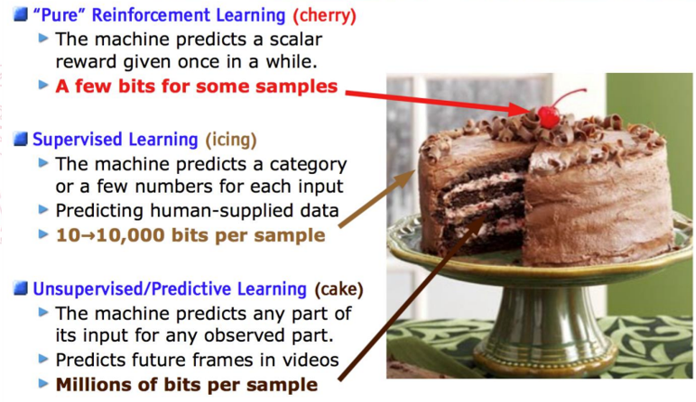
Theories of Language Models
Training Language Models
· Pre-training
· Supervised Training
· Reinforcement Learning

Slide 16
Theories of Language Models
Training Language Models
· Pre-training
· Supervised Training
· Reinforcement Learning

Slide 17
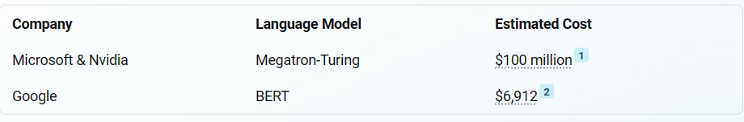
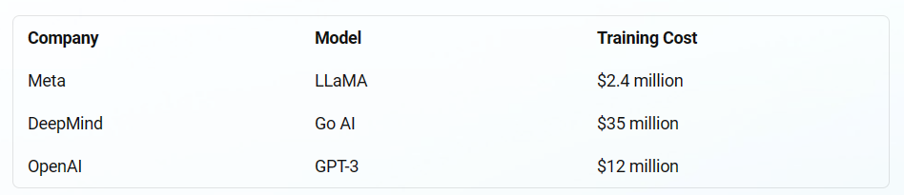
Different, Language Models
Harder to handle: Training cost

Slide 18
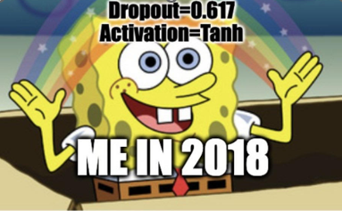
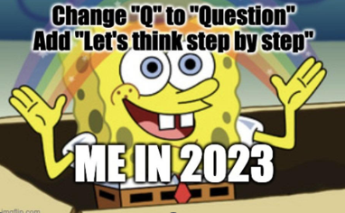
Different, Language Models
Easier to use: From fine-tuning to prompt engineering

Slide 19
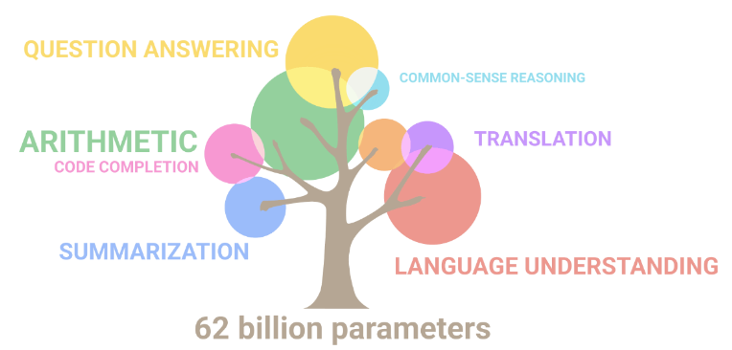
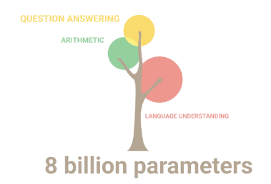
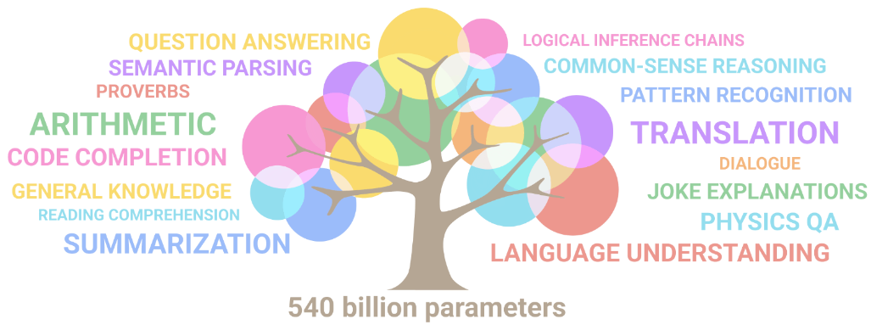
Different, Language Models
Solving real-word problems with general intelligence

Slide 20
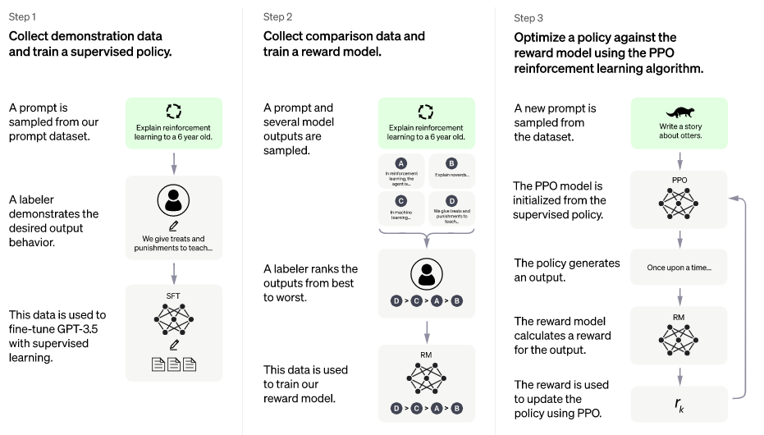
Examples and applications of LLMs
ChatGPT: Reinforcement Learning from Human Feedback

Slide 21
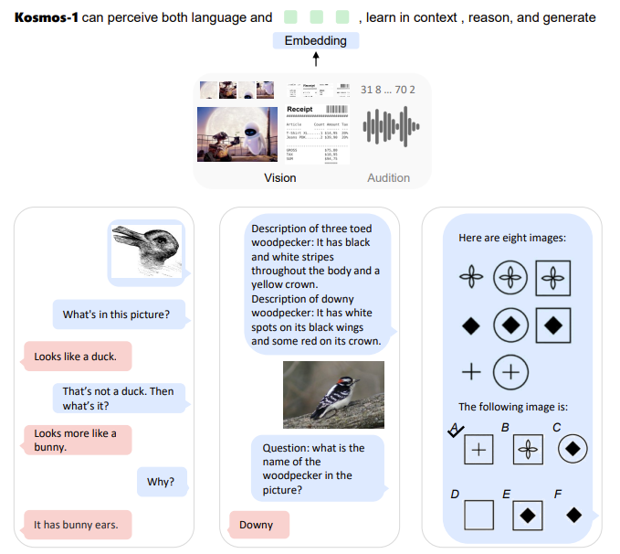
Examples and Applications of LLMs
Kosmos-1: Multimodal Large Language Models

Slide 22
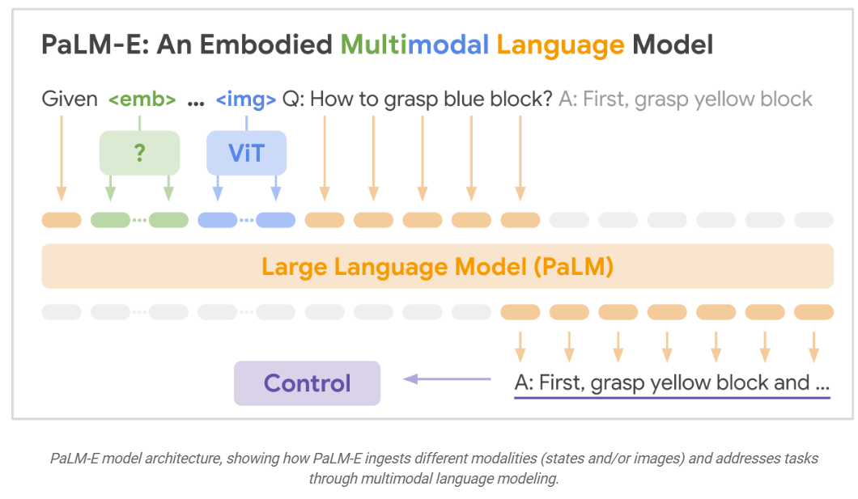
Examples and Applications of LLMs
PaLM-E: Embodied Language Models

Slide 23
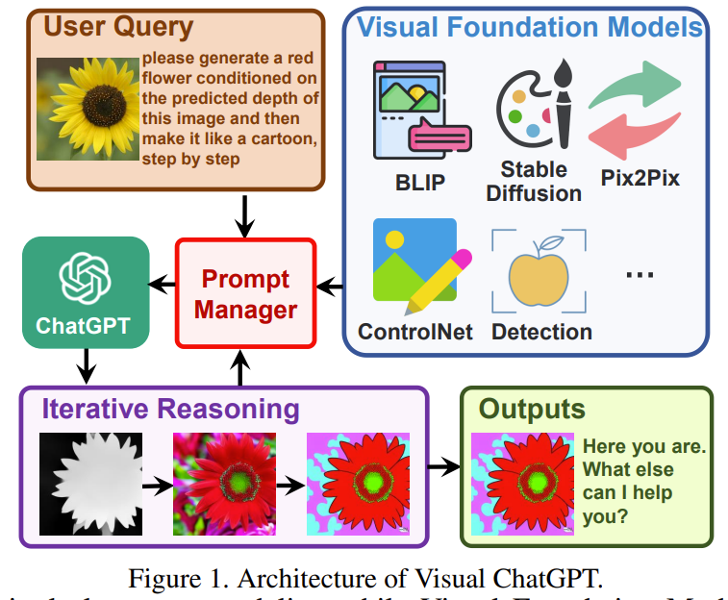
Examples and Applications of LLMs
Visual ChatGPT: Large Language Model + Visual Models

Slide 24
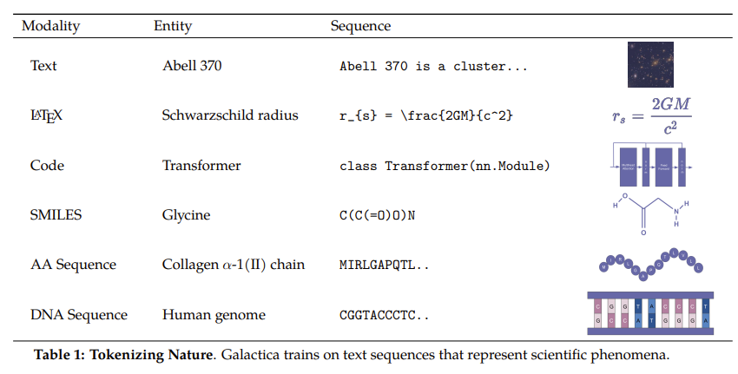
Examples and Applications of LLMs
Galactica: Language Model + Research Data

Slide 25

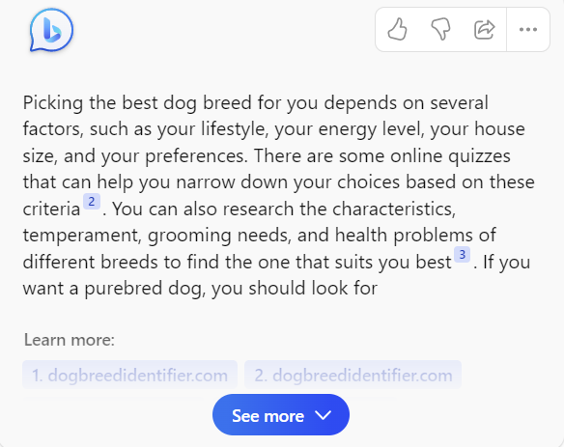


Applications

Slide 26
Applications
Education
Customer service / advisor
Knowledge Management
Recommendation
Virtual Assistant

Slide 27

Any Questions?

Slide 28

Thank You

